Slide 1



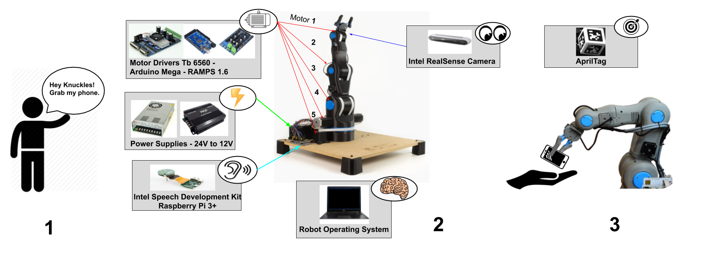
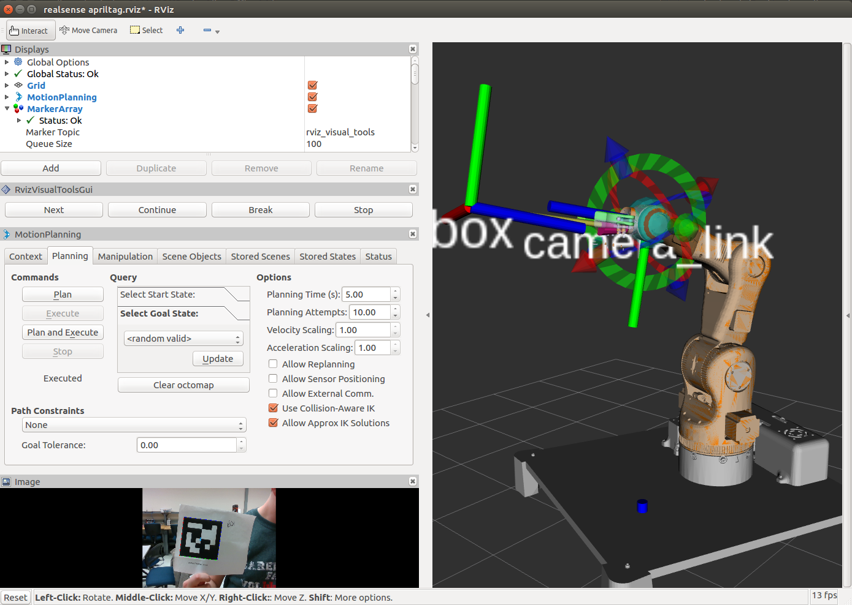
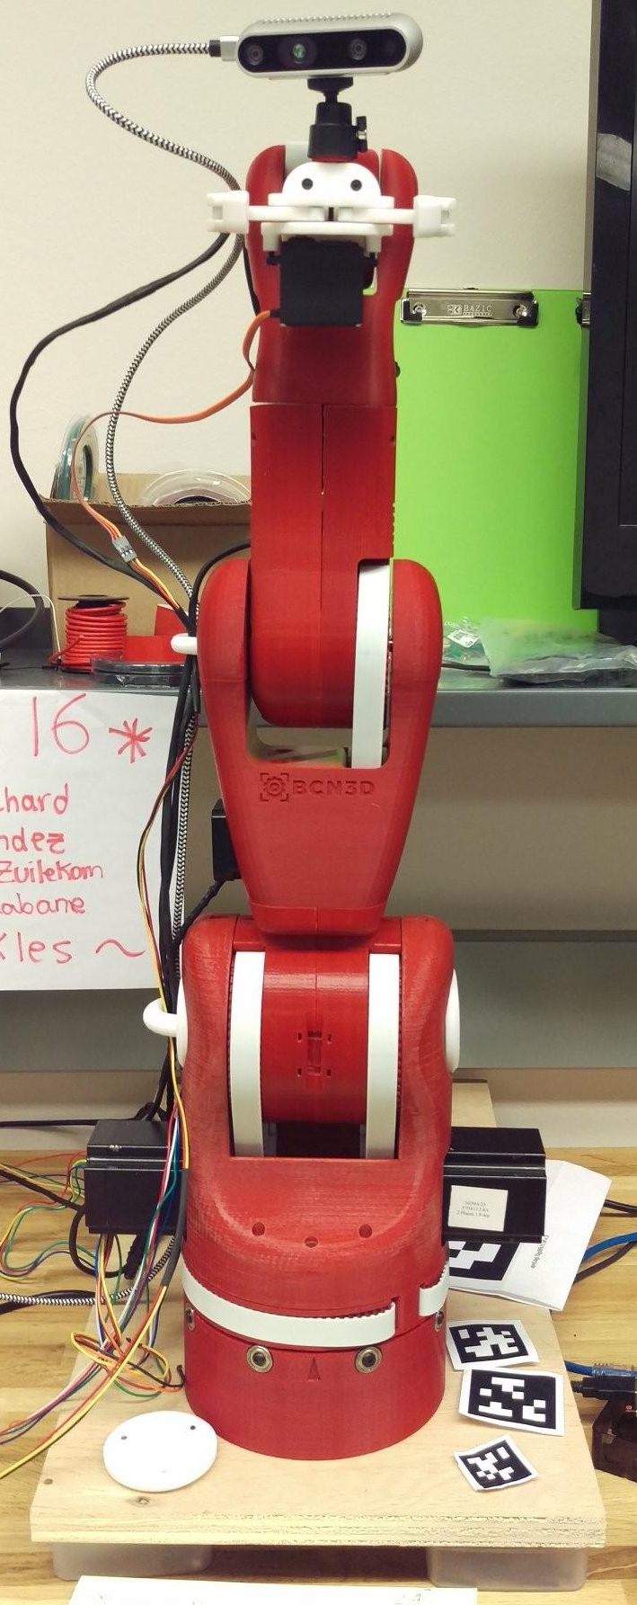
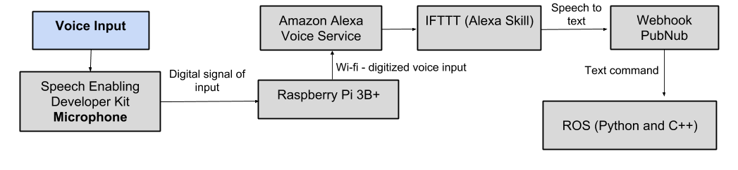
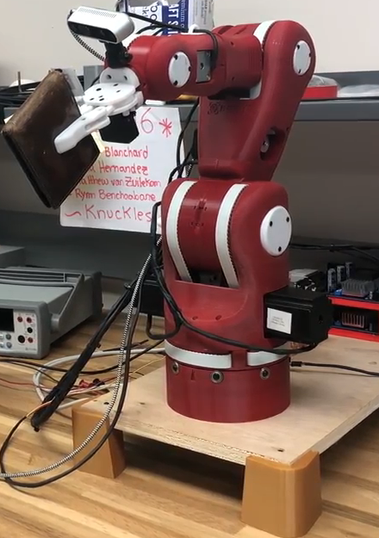
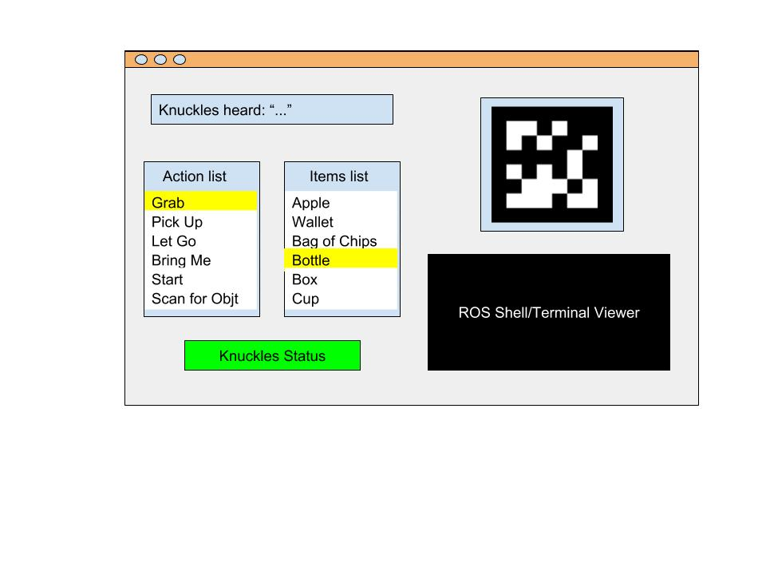
Knuckles, The Assistive Robotic Arm
Andrew Blanchard, Matthew van Zuilekom, Rym Benchaabane, Paola Hernandez Sponsored by IEEE UH Makers
IEEE UH Makers
Introduction
Problem: People are rushed and tend to multitask. According to the scientific journal, Current Biology, attempting to multitask reduces productivity by around 40%. SMF Mutual Insurance adds that multitasking can lead to dexterity incidents while performing hands-on work.
Need: A tool that will help the user multitask, increase productivity and avoid dexterity incidents.
Purpose
A voice activated, assistive robotic arm that will retrieve items from within its workspace upon request. It is designed to assist those who are limited in physical capacity while also being able to increase overall productivity.
Specifications
Degrees of Freedom (DOF) Arm – Five
Accuracy Voice Interpretation – 90%
Minimum Voltage for Motors – 12V
Object Detection – AprilTags
Object Count Library – 8
Response phrases - 64
Response Time – 7 seconds
Maximum Grabbing Reach – 0.5 meter
Maximum Weight Rating – 0.5 kg
Design Considerations
Voice Input
Multi-directional Microphone: Allows user to be heard from anywhere within room
Alexa Voice Service: Convert voice-to-text without developing a voice recognition library
Camera Input
AprilTags: Tags provide the translation, distance, and orientation with respect to the camera instead of using an object detection algorithm
RealSense Camera: Small lightweight camera
Power System
120V Mains: Knuckles can easily be plugged in anywhere.
24V Converter: To provide 24V to some motors if more power is needed
12V Converter: To provide 12V to some motors
Graphical User Interface
User-friendly Interface: To view Knuckles’ status and program updates
Features
Powered by Mains (120V AC)
Integrated Microphone
Integrated Camera
Object Detection with AprilTags
Voice-Control using Alexa Voice Service
User-friendly GUI
Wi-Fi required
Figure 2. Overview diagram of Knuckles’ functionalities
Figure 4: Voice input processing block-diagram
Figure 3: Simulation of AprilTag detection on Rviz (ROS)
Conclusions
Impact: Proof of concept, Knuckles is a robotic arm that provides hands-free assistance.
Future work:
Implementation of object detection program (can recognize any object, not dependent on AprilTag detection)
Multi-directional microphone: Knuckles should turn towards the user to provide the object.
Place Knuckles on a mobile base so he can move around his environment; be able to better assist the user
Figure 5: Left: Knuckles providing a wallet to the user Right: Knuckles in upright position
Acknowledgements Our team would like to thank Dr. Roysam, Dr Becker, Dr. Trombetta, Dr. Litvinov, Rhema Ike, George Godinez, Yang Nguyen & Aaron Hollaway for their advice and valuable contribution
Figure 1 Graphical User Interface
Table or Figure
Output of “trigger” and “status” from IFTTT/PubNub, and output of Knuckles from terminal windows
Notes:
Add bibliography
Adjust design considerations, adjust conclusions, adjust introduction, get Aaron’s last name

